Slide 1

G2M Case Study
Virtual Internship
14-Feb-2021

Slide 2
Background – G2M insight for Cab Investment firm
XYZ is a private firm in US. Due to remarkable growth in the Cab Industry in last few years and multiple key players in the market, it is planning for an investment in Cab industry and as per their Go-to-Market(G2M) strategy they want to understand the market before taking final decision.
Objective : Provide actionable insights to help XYZ firm in identifying the right company for making investment.
The analysis has been divided into four parts:
Data Understanding
Cost and Price charged distributed across different cities
Finding the most profitable Cab company
Recommendations for investment

Slide 3
Data Exploration
19 Features (including 5 derived features)
Timeframe of the data: 31/01/2016 to 31/12/2018
Total data points : 359392
Observations:
Price Charged is not linear unlike Cost of Trip. As the distance increases price charged also increases drastically after travelling certain KM.
Profit of rides are calculated keeping other factors constant and only ‘Price Charged’ and ‘Cost of Trip’ features used to calculate profit.
Users feature of city dataset is treated as number of cab users in the city.

Slide 4
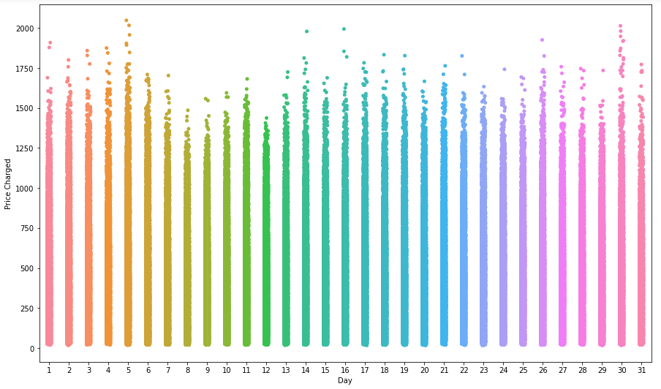
Profit Analysis
Daily Price Analysis
There is some seasonality over a month. Price charged is higher in the beginning and the mid of a month.

Slide 5
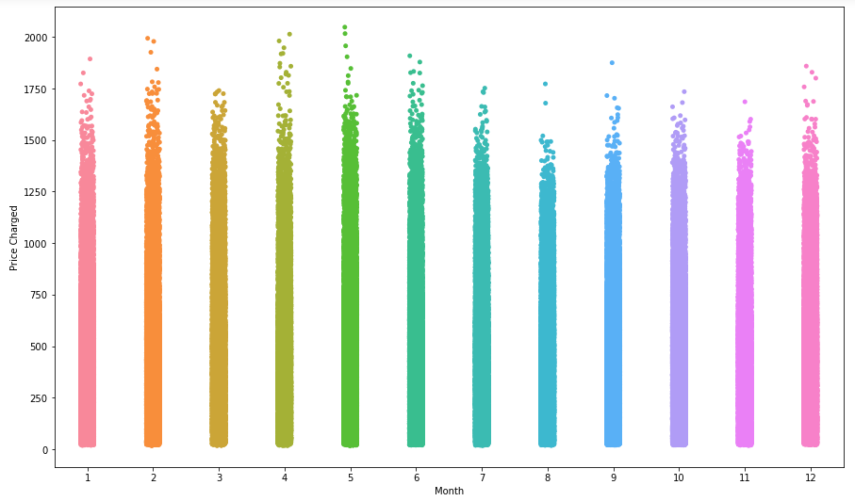
Monthly Price Analysis
There is some seasonality over a year. In the 2nd quarter i.e. during the months of April, May and June people tend to travel larger distance and hence the price charged is more.

Slide 6
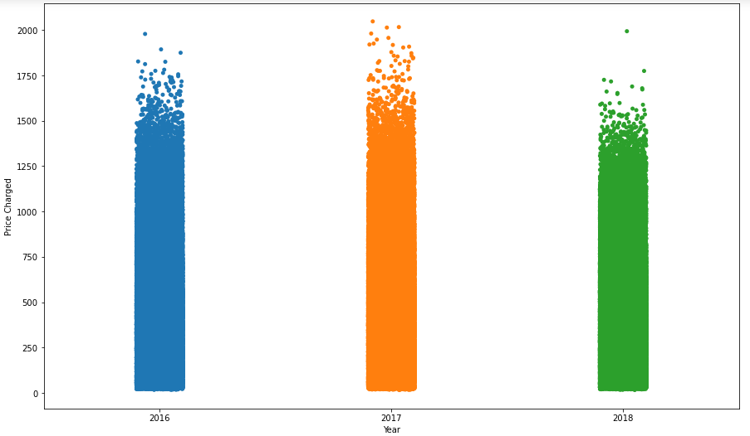
Yearly Price Analysis
In 2018 price charged was comparatively less than 2017 and 2016.

Slide 7
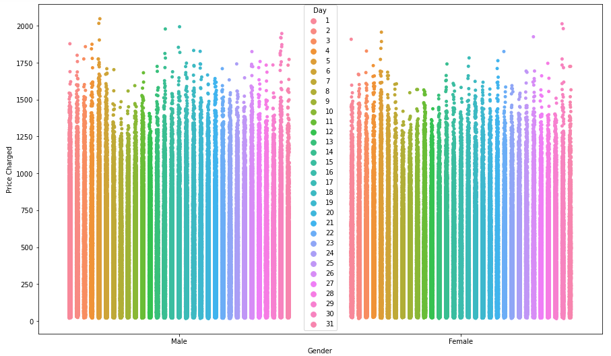
Price difference based on gender
There is no discount for Female customers as the price distribution is very similar for both the gender considered over monthly.

Slide 8
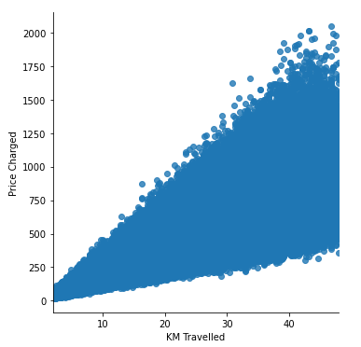
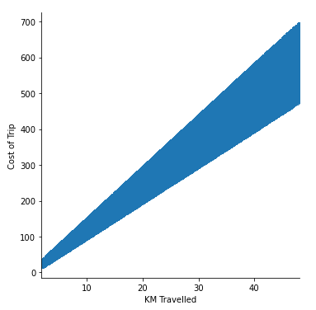
Price Vs. Cost
There is more pronounced linear relationship in Cost than Price charged as distance increases

Slide 9
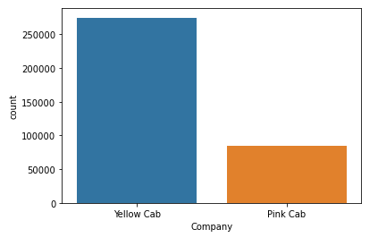
Preferred Cab Company
Yellow Cabs are used more than Pink Cabs. More than 76% cabs running are Yellow Cabs which implies customers prefer Yellow Cabs often.

Slide 10
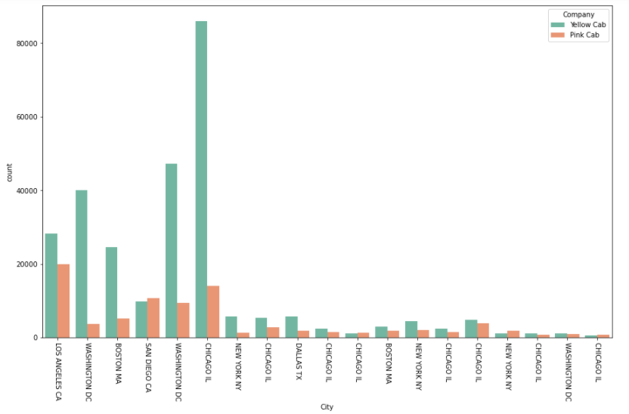
City Wise Cab Users Covered By Company
Except few cities 'Yellow Cab' Company is dominant in all the cities, i.e. Yellow Cabs is more preferred across all cities.

Slide 11
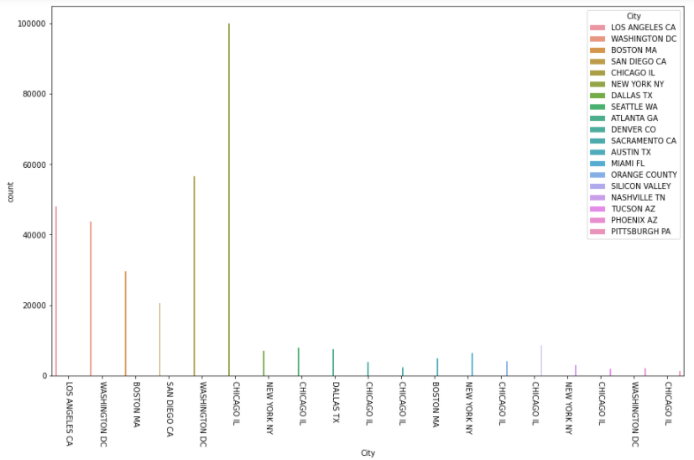
Number of customers city wise
Chicago has the highest no. of customers for cab service.

Slide 12
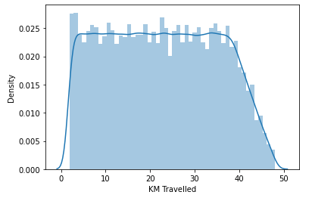
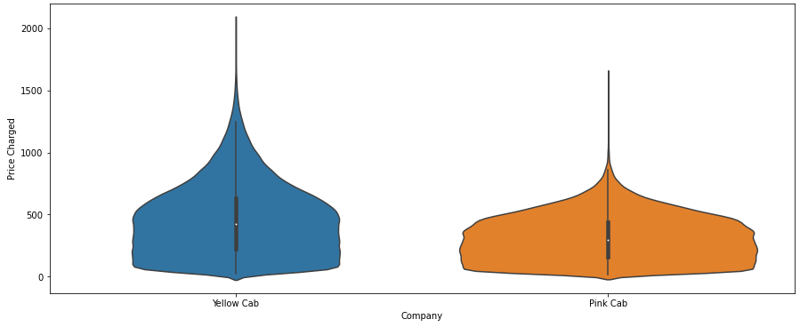
Distance and Price charged Company wise
Range of distance travelled via cabs lies from 1.9 KM to 48 KM.
Price charged by Yellow Cab Company is higher than Pink Cab Company.

Slide 13
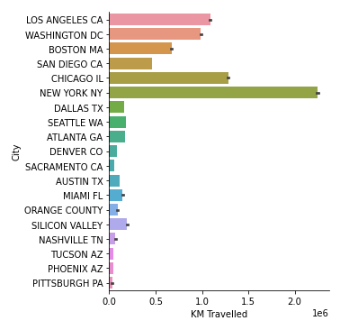
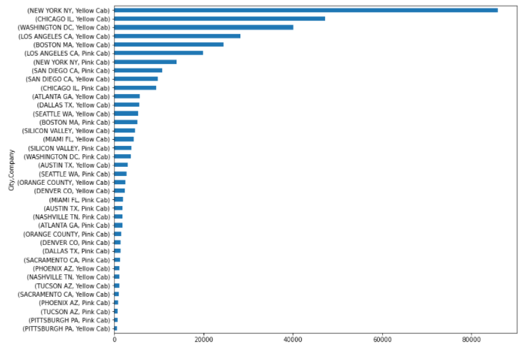
Distance covered City wise
New York City has the highest no. of KM Travelled!
Again New York City has most of the cabs as Yellow Cabs

Slide 14
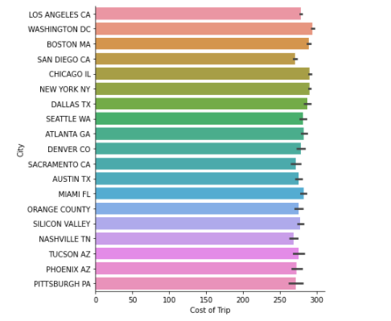
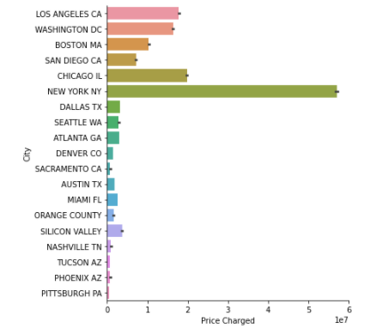
Cost Vs. Price City wise
Price charged is max for New York City. But the cost is almost the same as other cities. It could mean that New York city is expensive.

Slide 15
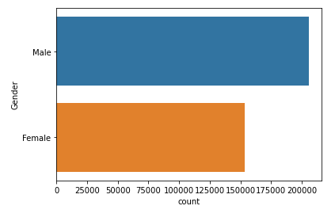
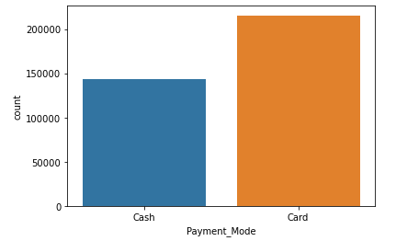
Gender & Payment Analysis
There are about 50 Lakhs more Male customers than female
Card payment is preferred over cash payment. About 1.5x!

Slide 16
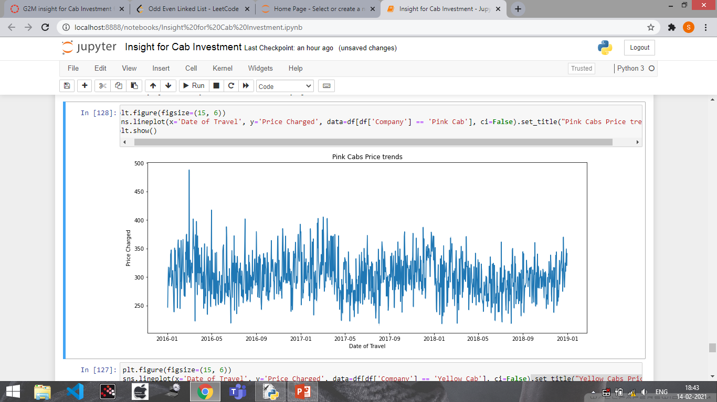
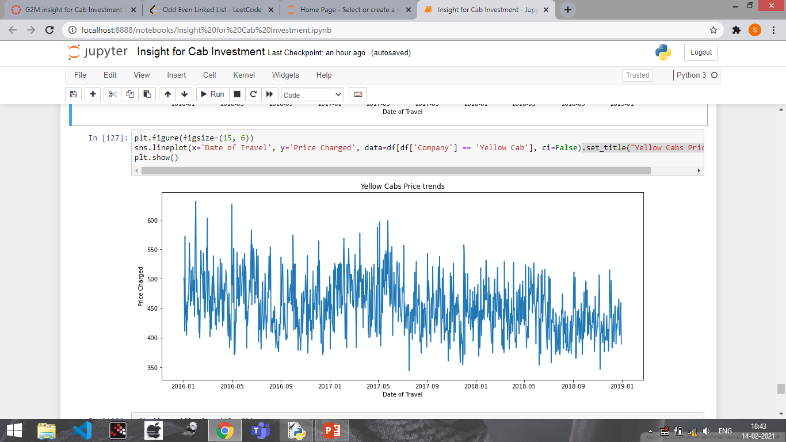
Seasonality Company wise
It is clear that there is some seasonality

Slide 17
Recommendations
We have evaluated both the cab companies on following points and found Yellow cab better than Pink cab:
Customer Reach : Yellow cab has higher customer reach in most of the cities while Pink cab has higher customer reach in very few cities.
Target New York : In the 2nd quarter (i.e. during April, May, June) people tend to travel larger distance. In New York city, people travel larger distance as compared to any other city. So we can prioritize New York city in the 2nd quarter.
Mode of payment : Card payment is preferred over cash payment generally so XYZ private firm could offer some discounts on card payment which would further increase the no. of customer which in turn would increase the profit.
Average Profit : It was observed that the cost of travel was uniform across the cities but the price charged was the highest in New York city.
Chicago : City with highest number of customers for cab service.
Gender : It was observed that there are about 50 Lakhs male customers more than the female customers.
After analyzing all the points, Yellow Cab Company is highly recommended for investment.

Slide 18
Thank You

